Slide 1

Impeccable Services & “Relationship-First”

Slide 2



What is ”Master•Care”?
Master•Care is a comprehensive approach to managing the complex post-acute care needs of older patients, ultimately improving quality of care and shortening length of stay.
The Master•Care Plan is the result of a comprehensive assessment and encompasses:
Medical
Behavioral
Social
Environmental
ADLs, and
Financial needs
Master•Care Navigation provides continual advocacy and support to assure patients first utilize Primary Care and “In Lieu of” pathways as opposed to E.D., acute-care and SNF…
NOTE: the term “In Lieu of” has been replaced with COMMUNITY SUPPORTS

Slide 3


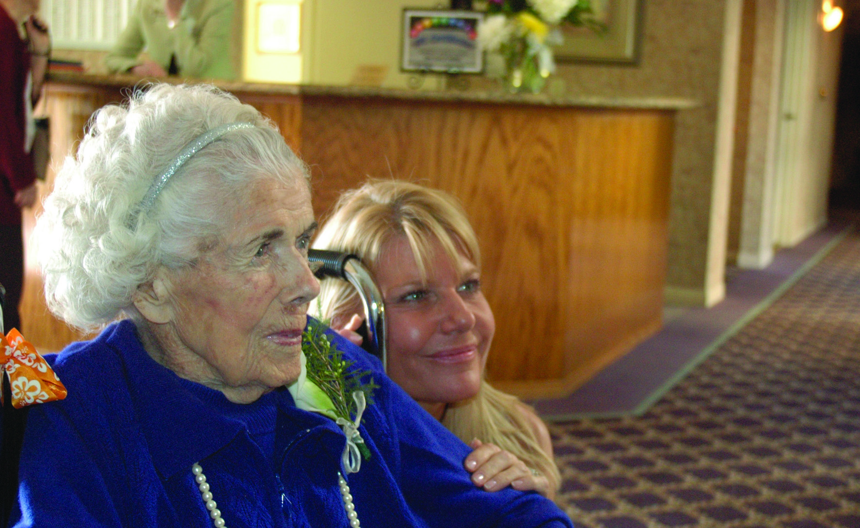
Master•Care
Growing Population
In 2025, over 15.6 million Americans will top 80 years old, an increase of nearly 30% over 2015.
In 2045, 31.6 million will be 80+, essentially doubling in 20 years and representing over 8% of all Americans.
Created to address the challenges of remaining independent while aging and the opportunities available as CMS (and others) realize that SDoH have a significant impact on financial and clinical outcomes.
Consumers (Older Adults & Families)
Senior Living Providers
Health Care Providers
Risk Bearing Entities
It’s Personal

Slide 4



The Problem(s)
Cost of Medical Care
Cost of senior Care
MEDICAL
Affording Senior Care
$800B
68%*
Cost of Medicare 2022
Of callers
could not afford Senior Care
Medical costs for Seniors
unsustainable
as Boomers age
Home-without-care
can be a risk
living in Skilled nursing facility is expensive burden
(unsuitable for dementia)
*Data from Looking for Care, Inc

Slide 5


The Opportunity
MANAGED Care Starting to pay for “In-lieu-of” services
Senior living industry Decimated by Covid
“In-lieu-of” services are services or settings a plan substitutes for a similar service covered under the contract. ... These services provide considerable flexibility for plans to go beyond services defined in the Medicaid state plan to address social needs.
JANUARY 1, 2022
CAL-AIM
Includes coverage for
Non-Medical
Care
78.8%*
Historic low Occupancy
“…assisted living has proven its position as a core component of the nation’s healthcare industry.”
Brenda Bacon, CEO Brandywine Living
EXAMPLES:
MeD mgmt.
Dressing
Bathing
Med. Respite
Home Mods.
OPPORTUNITIES:
MANAGED CARE CONTRACTS
REVENUE: DAY 1
PLUS VALUE-BASED COMPENSATION

Slide 6



The Solution
REDUCE Cost of Medical Care
Pay the Cost
of senior Care
Makes caring for
Older Adults
sustainable
Deliver the right care in the right environment….
paid for by Managed Care
Makes Senior Care
Affordable
by partnering with
Managed Care to
improve clinical &
financial outcomes
Improves Senior living industry
Improves Senior CARE
Decreases
E.R. VISITS, SKILLED NURSING & ACUTE CARE
Integrates
Medical, Behavioral,
Social and ADLs
into one Master•Care Plan
INTEGRATES
Senior Living
with
Health Care
Professionals

Slide 7




Big Changes
CalAIM
ECM
ILOS…
“Community Supports”

Slide 8


What it Means
Managed Care Plans – will be administering Medi-Cal
More / Different Benefits for Most Vulnerable / Highest Healthcare Consumers
Case-by-case “In-Lieu-of…” or “Community Supports” Services -
Social Determinants of Health (SDoH)

Slide 9






Referral
(i.e. from E.D.)
Discharge
Consent
H & P / Medication List
PT Notes / Psych Eval / Cognitive
Master•Care Navigator
Master•Care contacts PCP
Early in the process…
If no PCP, one is identified and assigned.
EMERGENCY
Marshall Hospital Refers Patient to Master•Care
Master•Care Navigator obtains consent, collects H & P, Med List, etc.
PCP is notified and PCP engagement is encouraged

Slide 10

Referral
(i.e. from E.D.)
Discharge
Consent
H & P / Medication List
PT Notes / Psych Eval / Cognitive
Master•Care Navigator
Comprehensive Assessment
includes:
Medical
Behavioral
Social
ADLs
Environmental
assessments
assessments
Patient
Family /
Caregiver(s)
Home /
Environment
EMERGENCY
Oversight provided by:
Navigator Team
Nurse
MSW
Pharmacist
Master•Care Navigator Assesses:
Patient • Family / Caregivers • Home / Living Environment

Slide 11
Referral
(i.e. from E.D.)
Discharge
Consent
H & P / Medication List
PT Notes / Psych Eval / Cognitive
Master•Care Navigator
assessments
assessments
Patient
Family /
Caregiver(s)
Home /
Environment
EMERGENCY
Oversight provided by:
Navigator Team
Nurse
MSW
Pharmacist
💲
Financial assessment
💲
Master•Care Explores Patient’s Financial Options
Assets • Community Resources • Bridge Funding • VA

Slide 12
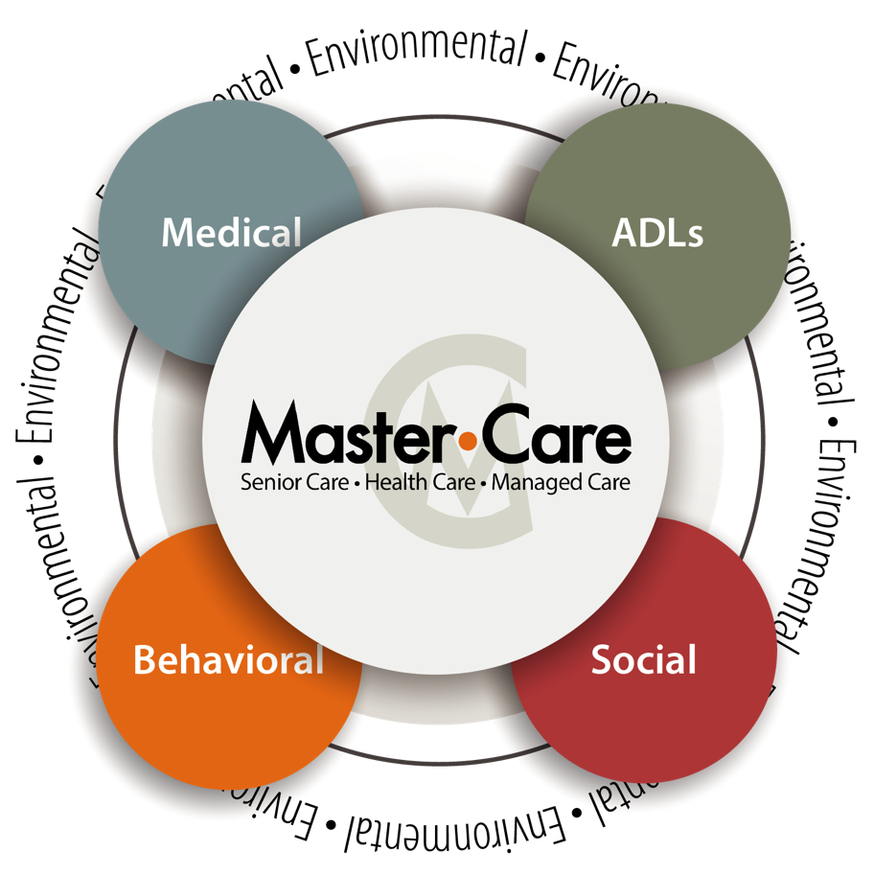
Referral
(i.e. from E.D.)
Discharge
Sample:
Long-Term Goals
“Highest Level of Independence”
Return Home
Thanksgiving at “Grandma’s House”
Reduce E.D. Visits
Reduce Length of Stay
Immediate Needs
Rx Filled and Reviewed
Recuperative Care (Assisted Living)
P.T. Home Health
Apply to Social Security — increase S.S.I.
Short-Term Goals
PCP Appointment, Dental Appointment
Home Modification (deep clean, grab bars, bath-tub cut out)
Family Caregiver Training
Consent
H & P / Medication List
PT Notes …
Master•Care Navigator
assessments
assessments
Patient
Family /
Caregiver(s)
Home /
Environment
Plan Includes:
Immediate Needs (for DC)
Short-Term Goals
Long-Term Goals
Oversight provided by:
Navigator Team
Nurse
MSW
Pharmacist
Master•Care Plan Developed
Communicated to Stakeholders at
Health Organization and to PCP
💲
Financial assessment
💲
Master•Care Plan

Slide 13
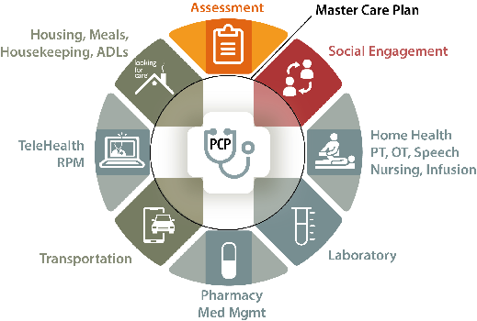

Referral
(i.e. from E.D.)
Discharge
Sample:
Long-Term Goals
“Highest Level of Independence”
Return Home
Thanksgiving at “Grandma’s House”
Reduce E.D. Visits
Reduce Length of Stay
Immediate Needs
Rx Filled and Reviewed
Recuperative Care (Assisted Living)
P.T. Home Health
Apply to Social Security — increase S.S.I.
Short-Term Goals
PCP Appointment, Dental Appointment
Home Modification (deep clean, grab bars, bath-tub cut out)
Family Caregiver Training
Consent
H & P / Medication List
PT Notes …
Master•Care Navigator
assessments
assessments
Patient
Family /
Caregiver(s)
Home /
Environment
Oversight provided by:
Navigator Team
Nurse
MSW
Pharmacist
💲
Financial assessment
💲
Master•Care Plan

Slide 14
Impeccable Service

Slide 15

You!
Important
Significant
Beneficial
Exclusive
Predominant
Valuable
Compelling
Notes:
Important
Significant
Beneficial
Valuable
Predominant
Compelling
Exclusive

Slide 16

49% Drawn to the Task itself
51% Drawn to the WARMTH
… or the way we make someone feel…

Slide 17



Check Yourself
“Center Before You Enter”
©2018 Looking for Care, Inc. CONFIDENTIAL
Notes:
Honor and Responsibility –
How prepared are you – Are you “Race Ready”?
Are you bringing your children, your spouse, your parents, your car problems to work with you?
Are you in a healthy state? Mind, body, spirit
If you aren’t — what can you do?
“Labrador Mind” and “Monkey Mind”
It takes a Village – Ask for help
If you aren’t Ready – Change it…right NOW!

Slide 18
CENTER
before you
ENTER

Slide 19
The Care Swirl
Social Needs
Care Needs
PATIENT
Family Dynamics
Clinical Needs
Financial
Issues
Location /
Proximity
Notes:
Resident –
Care Needs
<ask>
<ask> Financial
<ask> Family
Social Needs
Location

Slide 20
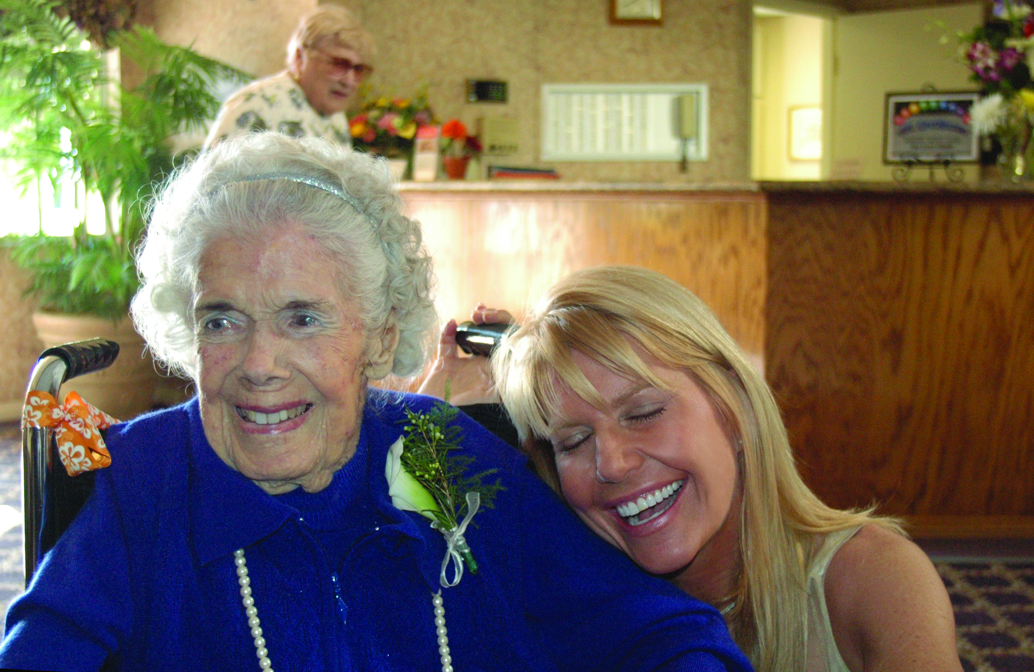
Honor
&
Responsibility
Notes:
Honor and Responsibility…
It is the Mission of Master•Care, Inc. to improve the post-acute lives of older adults,
support their families, and partner with those who care for them.

Slide 21


Labrador vs. Monkey Mind
©2018 Looking for Care, Inc. CONFIDENTIAL
Notes:
“Labrador Mind” and “Monkey Mind”
It takes a Village – Ask for help
If you aren’t Ready – Change it…right NOW!

Slide 22
Check Yourself
“Center Before You Enter”
©2018 Looking for Care, Inc. CONFIDENTIAL
Notes:
Honor and Responsibility –
How prepared are you – Are you “Race Ready”?
Are you bringing your children, your boyfriend, your parents, your car problems to work with you?
Are you in a healthy state? Mind, body, spirit
If you aren’t — what can you do?
“Labrador Mind” and “Monkey Mind”
It takes a Village – Ask for help
If you aren’t Ready – Change it…right NOW!

Slide 23

Strategies
Definition of a ‘Solution’
The method or process of solving a problem
The answer to or disposition of a problem
The homogeneous mixture of two or more substances,
which may be solids, liquids, gases, or a combination of these
Center-before-you-Enter
Send up a Flare...You ARE NOT alone
Be Gentle with Yourself – H.A.L.T.
Be “In Solution”

Slide 24
Relationship First
GO SLOW TO GO FAST
MIRRORING
Match the tempo
Check yourself — are you amped?
POINT YOUR HEART
EYE CONTACT!
Notes:
INVEST in relationship building
Mirroring – match tempo
Amped, anxious, distracted?
POINT YOUR HEART
EYE CONTACT

Slide 25

©2018 Looking for Care, Inc. CONFIDENTIAL
Notes:
“Look into my eyes…”
Is impossible.
We focus on a point –
Look at ONE EYE

